Slide 1
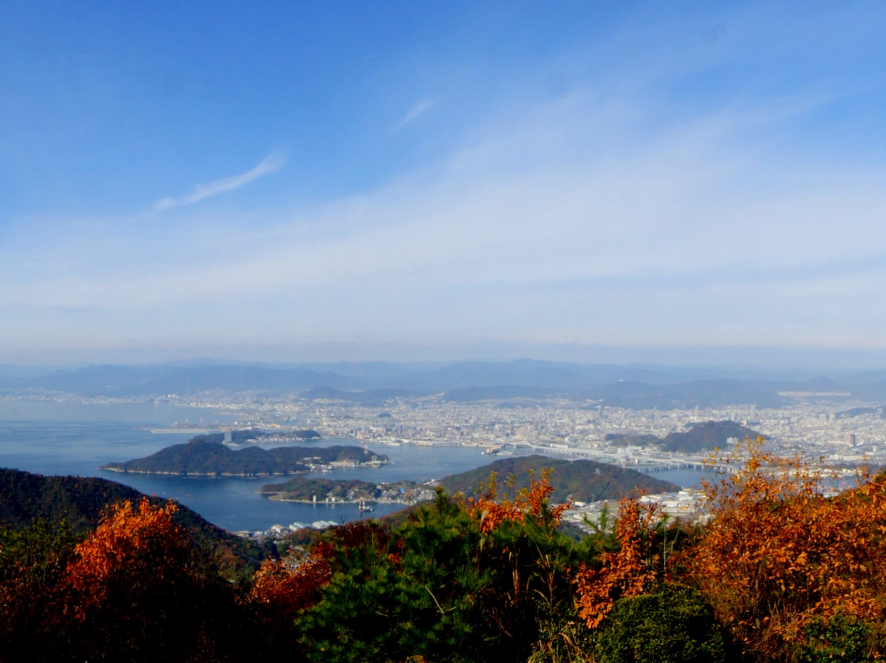
Hiroshima City’s Initiatives for Peace
-Toward the abolition of nuclear weapons
and the realization of world peace-
July 7, 2021
MATSUI Kazumi
Mayor of Hiroshima

Slide 2

1. Introduction
A special law based on Article 95 of the Constitution of Japan
The Hiroshima Peace Memorial City Construction Law
was enacted on August 6, 1949
Article 1 It shall be the object of the present law to provide for the construction of the city of Hiroshima as a peace memorial city to symbolize the human ideal of sincere pursuit of genuine and lasting peace.
Article 6 The mayor of Hiroshima shall, with the cooperation of residents and support from relevant organizations, establish a program of continuous activity toward completion of the Hiroshima Peace Memorial City.
Accomplish our goal of becoming an
“International Peace Culture City”

Slide 3
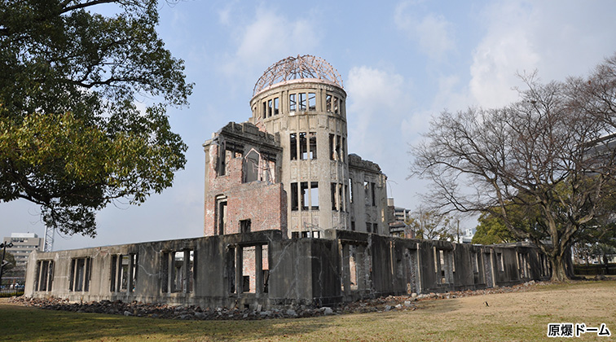
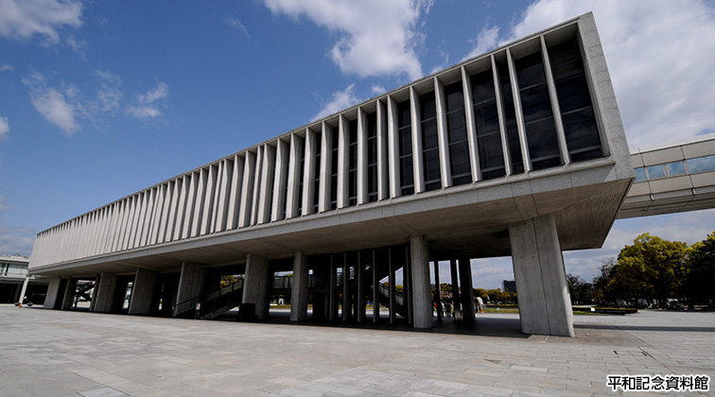

2. Efforts to “Preserve, Disseminate, and Convey” the Reality of the Bombing
Preserve
■Preserve A-bombed buildings and trees
■Collect A-bomb testimonies and materials
Disseminate
■Promote peace through welcoming visitors
・Call for visits by world policymakers
・Invite and hold international conferences
■Mayors for Peace
・Increase membership
・Raise global awareness of peace through solidarity among member cities
Atomic Bomb Dome
Convey
■ Reinforce sharing our will for peace with
the world
・Peace Declaration ・Peace Memorial Museum
・Train official A-bomb Legacy Successors
■Encourage youth-initiated activities
・Mayors for Peace youth exchange program
Peace Memorial Museum
2

Slide 4
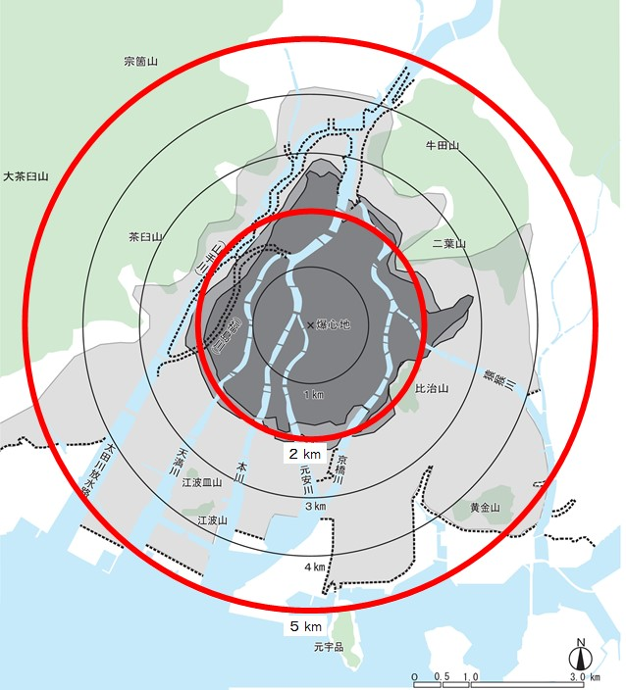
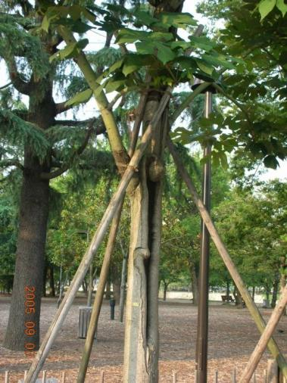
3. Preserve: Preserve A-bombed Buildings and Trees
A-bombed buildings and trees are valuable witnesses in passing on A-bomb experiences.
■ A-bombed Buildings
Criteria: Must be existing A-bombed buildings within 5 km from the hypocenter
Registered buildings: 86 (22 owned publicly, 64 owned privately)
■ A-bombed Trees
Criteria: Must be existing A-bombed trees within 2 km from the hypocenter
Registered trees: Approximately 160
Atomic Bomb Dome
Aogiri Phoenix Tree
3
Hiroshima’s Hypocenter

Slide 5
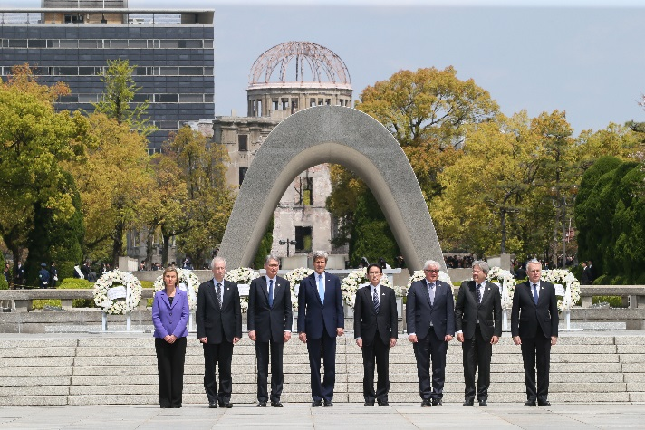
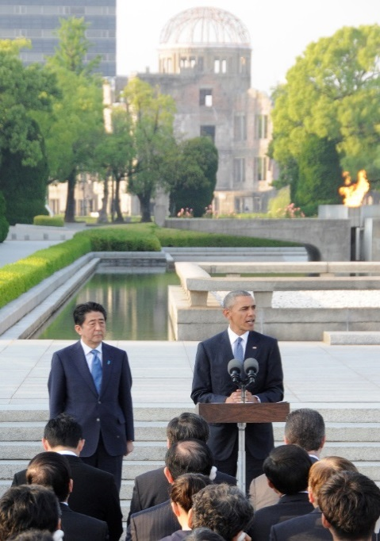
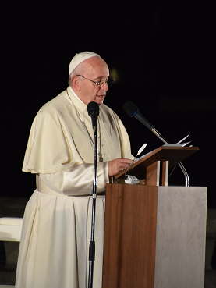
4. Disseminate: Promote Peace Through Welcoming Visitors
It is important to have many people, particularly policymakers from nuclear powers, come to Hiroshima to understand the reality of the atomic bombing, share in our hibakusha experiences and will for peace, and strive for nuclear abolition.
■ Urge policymakers from nuclear weapons states to visit Hiroshima
■ Invite international conferences to address issues regarding nuclear abolition
Pope Francis (Nov. 2019)
G7 Foreign Ministers’ Meeting in Hiroshima (April 2016)
US President Barack Obama
(May 2016)
4

Slide 6

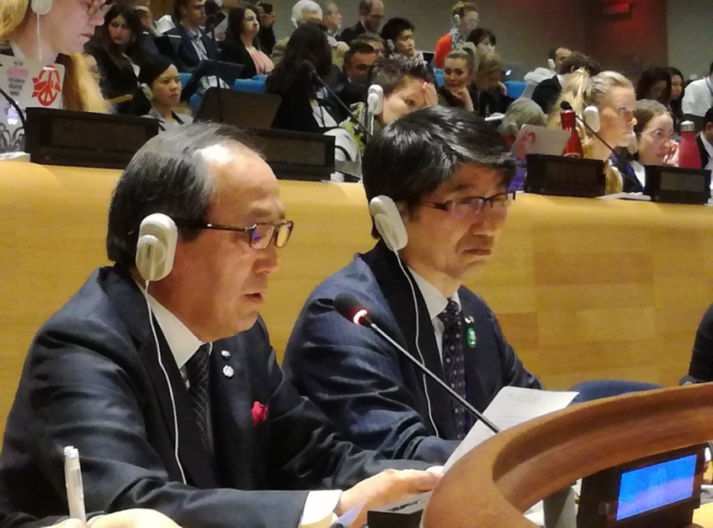
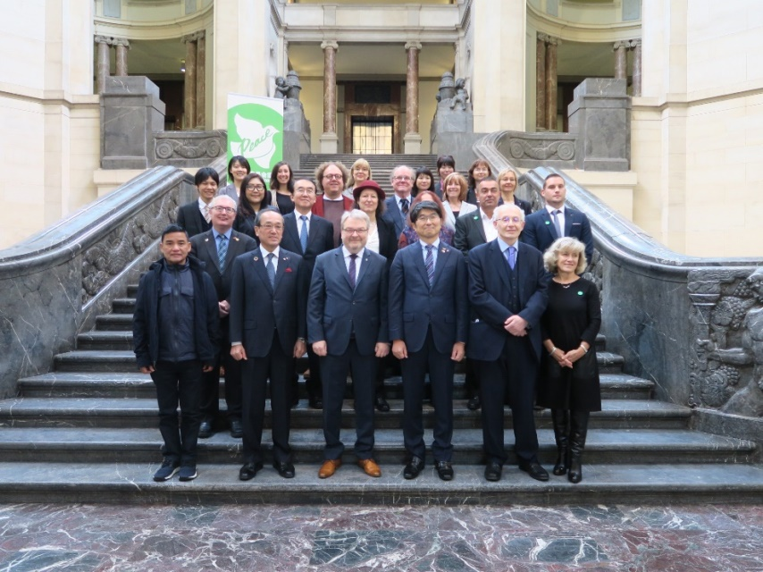
5. Disseminate: Mayors for Peace
■ Established in 1982
(registered as an NGO in the UN Economic and Social Council in 1991)
■ Membership: 8,037 from 165 countries and regions (as of July 1, 2021)
■ President City: Hiroshima
Vice President Cities: 14
5

Slide 7
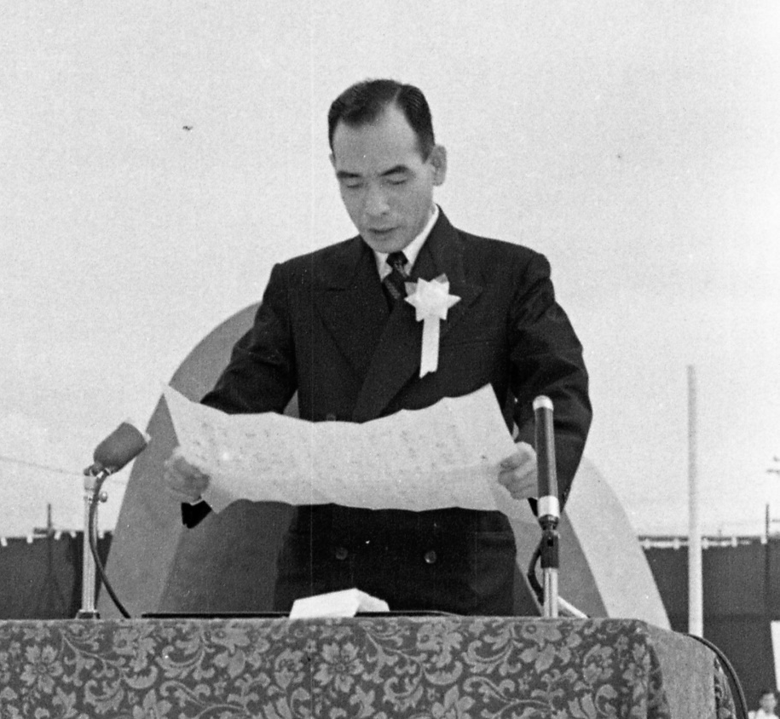
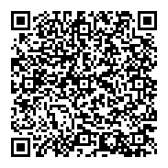
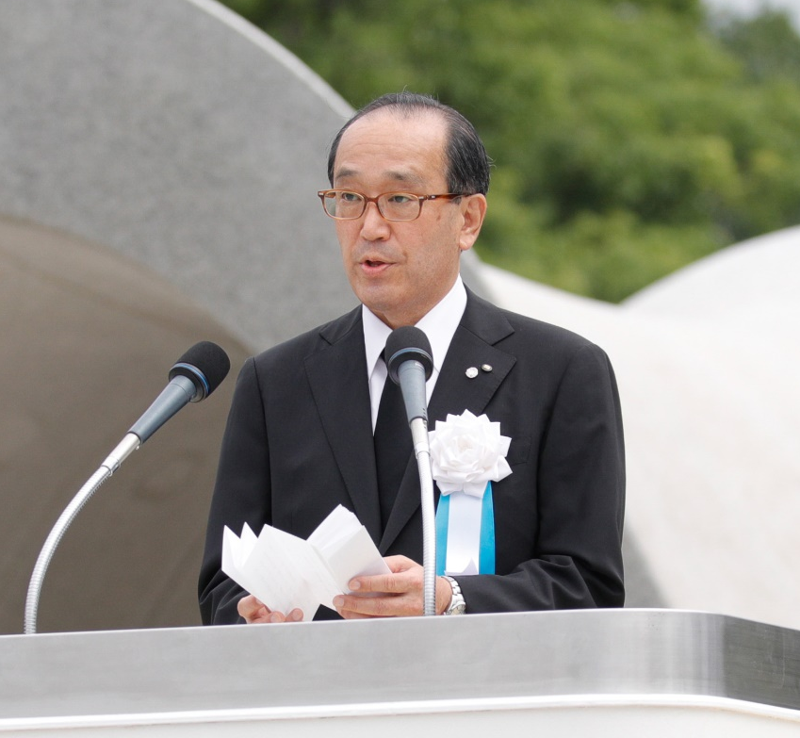
6. Convey: The Peace Declaration
■ Delivered by the mayor during the annual Peace Memorial
Ceremony on August 6.
YouTube video in English
Mayor Hamai delivering the Peace Declaration (1952)
Mayor Matsui delivering the Peace Declaration (2020)
6

Slide 8
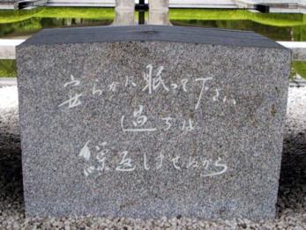
7. The Spirit of Hiroshima
The Will of the Hibakusha: No one else should suffer as we have.
Let all the souls here rest in peace;
For we shall not repeat the evil.
7

