Slide 1

The Update of Fukushima Daiichi NPS
Agency for Natural Resources and Energy
METI
25th February, 2020

Slide 2
1. The Mid-and-Long-Term Roadmap
Decommissioning of Fukushima Daiichi NPS will be done by TEPCO in its responsibility.
The decommissioning is an unprecedented work with technical challenges. The Government of Japan has been taking initiative based on the Mid-and-Long-Term Roadmap, with the target of the completion of decommissioning in 30-40 years in a safe and steady manner.
Time flame for Fukushima Daiichi Decommissioning
December
2011
November 2013
(Started fuel removal at Unit 4)
December
2021
30-40years from cold shut down
Now
End of 2031
Efforts for stabilization
Phase 1
Phase 2
Phase 3
Achieved cold shut down state
・drastic suppression in release of radioactive materials
Phase 3-(1)
Period until start of spent fuel removal (within 2 yrs.)
Period until start of fuel debris retrieval (within 10 yrs.)
Period until the completion of decommissioning (30-40 years from the cold shut down)
Role of the Government of Japan
GOJ sets the Roadmap
  The Inter-Ministerial Council for Contaminated Water and Decommissioning Issues has set out the Roadmaps.
  (Chairman: Chief cabinet secretary, First version: Dec. 2011)
  Revised for five times to date
  (Revised in July 2012, June 2013, June 2015, Sept. 2017, Dec. 2019)
Based on the “Roadmap”, mid-and long-term measures has been undertaken while giving top priority to the safety and keeping the attitude to value the risk reduction.
１

Slide 3
2. Key points of the revised “the Mid-and-Long-Term Roadmap”
● Setting out a basic principle of “coexistence of reconstruction and decommissioning”, while there has been gradual progress of residents’ return and reconstruction efforts in surrounding area.
(giving priority on early risk reduction and ensuring safety)
Coexist with local communities.
“Optimize the whole decommissioning tasks”, by reviewing the work process of 10 years.
●Total period of decommissioning is unchanged: “within 30-40 years”
(1) Fuel debris retrieval
Determine first implementing Unit and the method for fuel debris retrieval.
Start trial retrieval at Unit 2 within 2021, by partial submersion method and side access
The scale of the retrieval will be gradually enlarged.
(2) Fuel removal from pool
Change in the methods to suppress the dust dispersion at Unit 1 and 2
Postpone fuel removal for 4-5 years at Unit 1, and for 1-3 years at Unit 2
Aim at the completion of fuel removal from all Units 1-6, within 2031
(3) Contaminated water management
  The volume of contaminated water generated has been significantly suppressed.
  (540m³/day (May 2014) → 170m³/day (average of FY2018))
Keep current target of reducing the contaminated water generation to 150m³/d within 2020.
Set new target of reducing the contaminated water generation to 100m³/d within 2025.
* Handling of ALPS treated water will be continuously discussed in a comprehensive manner

Slide 4
3. Major milestones of Mid-and-Long-Term Roadmap (Dec. 2019)
Dec. 2011
Nov. 2013
Now
30～40 years after cold shutdown
Dec. 2021
End of 2031
Hold
Hold
Phase 1
Phase 2
Phase 3
Phase 3-(1)
Period until start of fuel removal (within 2 years）
Period until start of fuel debris retrieval（within 10 years）
Period until completion of decommissioning（30-40 years later）
Major milestones
Roadmap (Sept. 2017)
Revised Roadmap
Further reduction of generation
Contaminated water management | Reduce to about 150 m³/day Reduce to about 100ｍ³/day or less | Within 2020 ー | Within 2020 Within 2025 NEW
Stagnant water treatment | Complete stagnant water treatment in buildings* | Within 2020 | Within 2020(*)
 | Reduce the amount of stagnant water in buildings to about a half of that in the end of 2020 | ー | FY2022 - 2024 NEW
Fuel removal | Complete of fuel removal from Unit 1-6 | ー | Within 2031 NEW
 | Complete of installation of the large cover at Unit 1 | ー | Around FY2023 NEW
 | Start fuel removal from Unit 1 | Around FY2023 | FY2027 – 2028 REVISED
 | Start fuel removal from Unit 2 | Around FY2023 | FY2024 - 2026 REVISED
Fuel debris retrieval | Start fuel debris retrieval from the first Unit | Within 2021 | Within 2021
 | （Start from Unit 2, expanding the scale gradually）
Waste management | Technical prospects concerning the processing/disposal policies and their safety | Around FY2021 | Around FY2021
 | Eliminating temporary storage areas outside for rubble and other waste | ー | Within FY2028 NEW
Methods have changed to ensure safety and prevent dust scattering
* Excluding the reactor buildings of Units 1-3, process main buildings, and High temperature incineration building.
3

Slide 5
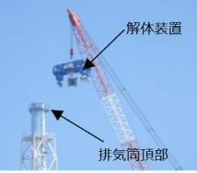
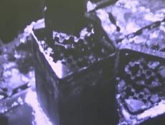
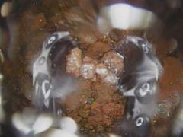

安全第一
安全第一
安全第一
福島第一
福島第一
福島第一

Slide 6

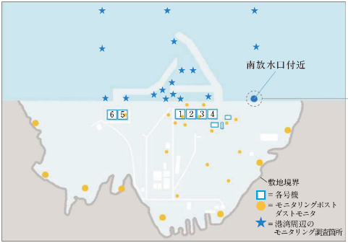

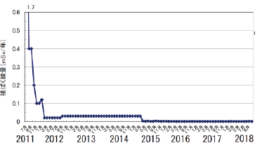
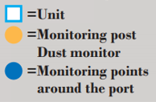
[Ref.2] Impact on the Surrounding Environment
The environmental impact on the site and surrounding area have been significantly reduced.
(Bq/L)
10,000 over
Sea
N
Guidance value recommended in the WHO Guidelines for Drinking water quality (10Bq/L)
Evaluation of annual exposure dose at the site boundary due to radioactive materials (cesium) from the reactors buildings of Units 1-4
Air
Near the south discharge channel
Radiation dose rate ( mSv/year)
There has been no effect of the radioactive material (dusts etc.) to the outside in the course of decommissioning work.
Whole map of Fukushima Daiichi Nuclear plant
5
Notes:
廃炉・汚染水対策の進捗に伴い、周辺環境への影響は大きく改善しています。福島第一原発周辺環境のモニタリングと、放射性物質の飛散に関する評価データを示していますが、いずれも大きく改善しました。

Slide 7

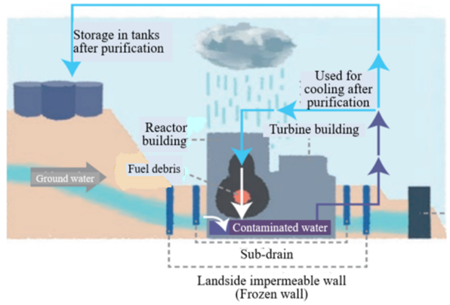
4. Generation of contaminated water, purification process and tank storage
Water gets contaminated when it touches the damaged reactors and fuel debris in buildings.
  The level of groundwater outside is controlled to be higher than that of contaminated water inside the buildings to prevent the water flowing out of the building.
  Groundwater keeps flowing into the buildings
TEPCO has been successful in removing most of radionuclides except tritium from contaminated water.
  ALPS (Multi-nuclide retrieval equipment) and the other equipment have been used. See more at P8
It is ALPS treated water, NOT -contaminated water, that is stored in the tanks.
Radioactive materials in ALPS treated water are reduced to about 1/1,000,000 (one millionth).
ALPS
② Most of the nuclides except tritium are removed in this process.
ALPS-treated water
Continuous injection of cooling water
③ Treated water is stored in tanks.
① Contaminated water is sent to purification equipment such as ALPS.
Fuel Debris
Damaged Reactors at FDNPS
Flow of groundwater
Contaminated Water
Sub-drain
Sea-side
Impermeable
wall
Land-side Impermeable wall
(frozen-soil wall)
6

Slide 8
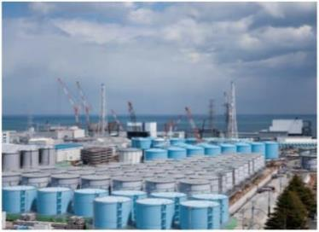
5. Key figures of ALPS treated water
Key Figures for ALPS treated water at the site (As of Dec 12, 2019)
Number of tanks | 965
Tank Storage volume | About 1.18 million ㎥
Planned capacity (Under current plan) | About 1.37 million ㎥ (by the end of 2020)
Annual increase of ALPS treated water | About 50,000～60,000㎥/year
※ About 2 years will be needed for preparation and permission for disposal.
※There is a limited room for further tank construction
Time to reach its full capacity (forecast): around summer of 2022
Amount of Tritium (tritiated water) in tanks | Approx. 860 TBq* (16g) (*TBq = 1×10¹² Becquerel)
Average Concentration of Tritium | 0.73 MBq/L (*MBq = 1×10⁶ Becquerel)
※ As of Oct 31,2019
※Currently, several kinds of radionuclides other than tritium are found in ALPS treated water in tanks. → See page 8
※ If the treated water is discharged into the environment, it will be re-purified and diluted to meet the standards for discharge.
7

Slide 9
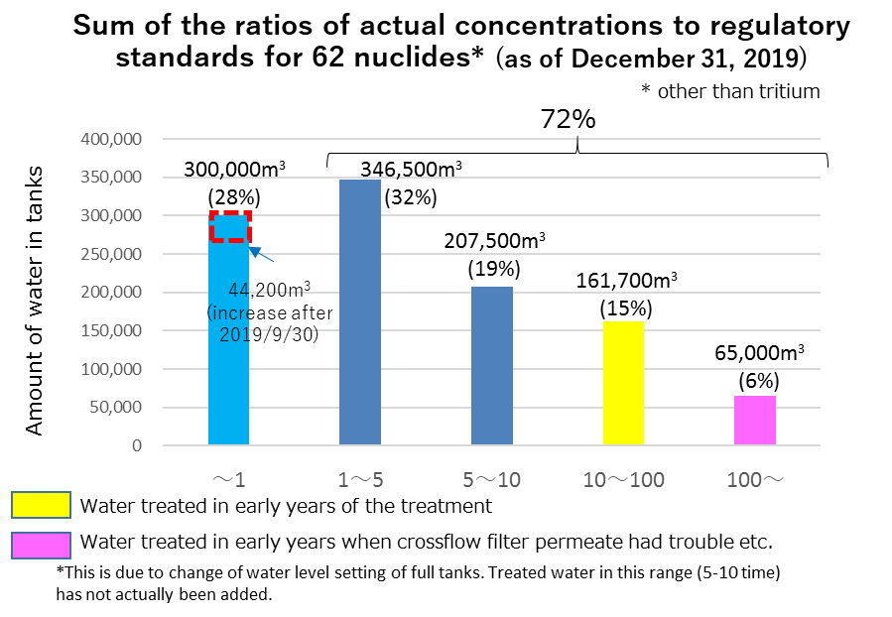
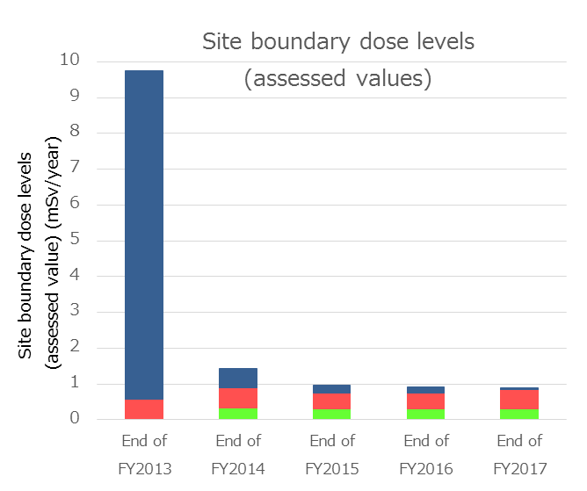
6. Characteristics of ALPS treated water
Two regulatory standards:
1) Applicable to storage: to keep site boundary dose levels less than 1mSv/year Goal currently achieved through ALPS
2) Applicable to release to the environment: to keep radionuclides concentrations of treated water less than the regulatory limit.
There are various concentration of ALPS treated water in the tanks, because:
  Concentration of ALPS treated water depends on the attributes of water to be treated and operation management of ALPS such as frequency of absorbent exchange; and
  Especially in the first few years after the accident, which was before improvement of ALPS performance, concentrations of tritium in ALPS treated water was relatively high.
In case of releasing ALPS treated water to the environment, the water needs to satisfy standard 2).
  TEPCO announced to re-purify ALPS treated water, to meet standard 2) for radionuclides other than tritium.
  After the re-purification, the water will be diluted to meet the standard 2) for tritium.
9.76
Site Boundary dose levels
Direct rays from tanks/skyshine
Direct rays from sources other than tanks/skyshine
Other (Groundwater bypass/sub-drains, etc.)
1.44
0.96
0.92
0.90
*These drawings are quoted from “Treated water `portal site（TEPCO HP）”

Slide 10
7. Process ahead
Role of the subcommittee:
1) to examine in a comprehensive manner, such as countermeasures for reputational damage, and
2) to compile report for the government
GOJ will decide its basic policy, after receiving report of subcommittee and discussing with parties concerned.
Share the discussion at subcommittee
Report
The Subcommittee
on handling of
ALPS treated water
Government
Stakeholders
(community people etc.)
１
２
Listen to opinions of parties concerned
Discuss from experts’ point of view
Request for
examination
Decide on basic policy
Approve
Nuclear Regulation
Authority
３
TEPCO
Measures for handling
Apply
Decide on engineering
9
Notes:
2013年から2016年に経産省が主催するトリチウム水タスクフォースにて5つの処分方法(地層注入、海洋放出、水蒸気放出、水素放出、地下埋設) 処理期間やコスト等を評価。
いずれも、生活圏への科学的な影響を生じないことを前提として検討。
ALPS処理水の取り扱いは風評などの社会的影響を与えうることから、2016年よりALPS小委員会にて議論されている。処分方法や処分した際の懸念について広く国民から意見を聞くために、我々は2018年8月に福島と東京で公聴会を開催した。
公聴会後、公聴会で出た様々な観点からの御意見について、ALPS小委員会にて議論している。
処理水の取り扱い方法については、現時点では決定していない。
From 2013 to 2016, “The Tritiated Water Task Force” under METI assessed the regulatory feasibility, technical feasibility (including monitoring to ensure safety), treatment period and cost of 5 disposal methods ; (1) geosphere injection, (2) offshore release, (3) vapor release, (4) hydrogen release, and (5) underground burial. All cases are examined on the premise that there is no scientific impact on the human habitant.
Since 2016, The treatment of ALPS treated water is been discussed in “the subcommittee on handling ALPS treated water” as harmful rumors can have a social impact. For the purpose of listening the concerns on disposing water and the methods for disposal from the public widely, we had held public hearing in Fukushima and Tokyo in August, 2018.
After that, under the subcommittee, we are discussing the opinion on various viewpoints gathered at the public hearing.
Although the method of handling treated water has not been decided yet.

Slide 11
8.The key points of the report (1): Basic approach
Reputational damage still remains and affects reconstruction of Fukushima.
"Coexistence of reconstruction and decommissioning" is a basic principle:
- Returning of residents and reconstruction efforts in the surrounding area have been proceeding.
- Additional reputational damage should not be caused by a hastened disposition of ALPS treated water.
Disposition of ALPS treated water needs to be completed until the completion of the decommissioning:
- with necessary storage, and
- with due consideration to the minimization of the impact on reputation
In deciding the disposition of the ALPS treated water, the government must also compile a policy for countermeasures against reputational damage.
10

Slide 12
9. The key points of the report (2): disposal methods
Vapor release and Discharge into the sea have been conducted and recognized as feasible methods.
There are precedents for discharge into the sea in Japan and it is easy to operate necessary facilities. Thus this can be conducted with certainty.
Radiation impact of both methods is considerably small compared to natural exposure to radiation.
 | Vapor release | Discharge into the sea
Technical Issues | Precedent in case of accident at NPP overseas * Vapor is also released from reactors in normal operations at the time of ventilation. In Japan, there is no example of vapor release in order to dispose liquid waste. Difficult to predict how the released vapor is diffused into the air Difficult to establish proper monitoring methods | Precedents exist world-wide More reliable option * precedents in Japan and easiness of operating facilities Relatively easy to predict how discharged water is diffused in the ocean Easy to examine proper monitoring method
Social issues | Difficult to compare the social impacts of two methods * Social impact is greatly dependent on consumer psychology.
 | May attract significant social concern | May attract particularly large social concern if no countermeasure for reputational damage is taken
The following three options have many insurmountable issues (regulatory, technological, and timewise)
Geosphere injection：Need to seek for appropriate sites, and monitoring methods have not been established
Hydrogen release ：Further technological development would be required for pretreatment and scale expansion.
Underground burial ：In solidification process, water including tritium will be evaporated. New regulations may be necessary.
Area for disposal yard will be needed.
11

Slide 13
[Ref. 3] Impact assessment for environmental release of ALPS treated water
[Conditions]
Using UNSCEAR^{*1} assessment model^{*2} and precondition that all the treated water stored in tanks (containing 860TBq of tritium) is discharged in one year.
(*1: UNSCEAR: The United Nations Scientific Committee on the Effects of Atomic Radiation)
(*2: re-assessed with Japanese food consumption)
[Ref. UNSCEAR 2016 Report, Annex A “Methodology for estimating public exposures due to radioactive discharges”]
[case 1] Vapor release ------- Approx. 0.0012 mSv/year (1.3 μSv/year)
[case 2] Discharge into the sea ---- Approx. 0.000071 to 0.00081 mSv/year (0.071 to 0.81 μSv/year)
In both discharge methods, the impact of the radiation from the discharge is considerably small, compared with annual natural exposure in Japan: 2.1 mSv/year (2,100 μSv/year).
Exposure dose [mSv/y] | Vapor release^{※1} | discharge into the sea^{※2}
All radionuclides^{※3} | 0.0012^{※4} | 0.000071～0.00081
- tritium | 0.0012 | 0.0000068
※1 Sum of external dose from the atmosphere and soils, and internal dose from inhaling the air and ingesting terrestrial life (at 5km points from the FDNPS)
※2 Sum of external dose from beaches and internal dose from ingesting marine life.
※3 Estimation was conducted on the two assumptions that “ND (Not Detected)” nuclides are 1) their ND value and 2) zero.
※4 For exposure dose for [case 1 (vapor release)], there is no difference between the results from two assumptions
Comparison of radiation impact between natural exposure and
discharging treated water containing 860 TBq of tritium
0.0012 mSv/year
0.00081 mSv/year
2.1 mSv/year
0.5
1.0
1.5
2.05
2.1
2.2
mSv/y

Slide 14
10. The key points of the report(3):
Countermeasures against reputational damage
1) Well planned disposition process
2) Expansion and enhancement of countermeasures building on best practices
3) Continuous and flexible response
＜1. Well planned disposition processes ＞
Re-purify radionuclides other than tritium
Stop the disposition process in case of emergency
e.g. environmental situation, malfunction of facilities
Determine the details (starting time, volume, and period of disposition), while listening to opinions of stakeholders
Disseminate information in a considerate and an easy-to-understand manner
  Concentration of pre-disposition ALPS treated water
  Monitoring results of surrounding environment
Explain safety of surrounding environment by utilizing diffusion simulation
13

Slide 15
10. The key points of the report(3): - continued
＜2. Expansion and enhancement of countermeasures building on best practices＞
< Risk communication>
- to convey relevant information
Disseminating information on the disposal method and scientific knowledge in advance
Providing information via:
  Social media, mass media
  On-site lectures
Strengthening information dissemination abroad
  Basic information on decommissioning
  Disposition methods in the world as well as precedents outside of Japan
< Economic measures>
- for reputational damage
Constructing analytical framework for:
  Environmental monitoring, and
  Food sampling measurement
Utilizing third-party certification to secure consumer trust, such as
  GAP (Good Agricultural Practice)
  MEL (Marine Eco-label)
Developing new market channels by
  Promotion events for Fukushima products
  Allocation of special sales staff in stores
  Opening of on-line stores etc.
14

Slide 16
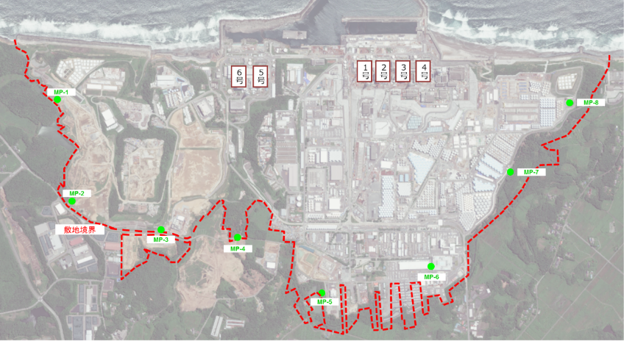
[Ref. 4] Possibility of storage continuation
There is a limited room for construction of additional tanks.
(Tank capacity under the current plan: approx. 1.37 million m³)
  Areas where flanged tanks used to be built may become available.
  For further decommissioning work, various facilities will be needed (such as storage tanks for ALPS treated water temporary storage facilities for spent fuel and fuel debris).
Entire premises should be used effectively, considering its limitation.
1 2 3 4
Soil dumping area
Facilities for waste will be built
Tank area
提供：日本スペースイメージング（株）2018.6.14撮影
Product(C)[2018] DigitalGlobe, Inc.
Notes:
ｊOKするには御金とかあるのか。⇒あると思うが、これから相談。
上の箱は不要。
図と一緒に説明する必要がある。わからない。
＋16とかも書いておけばよいじゃないか。外に巻くわけではないし。
何年のびる？5年4年
風評対策は具体的に書かないとわからないよ。
大気放出の留意点書いた方がよいよ。ちゃんと書いたら良い。
ワード1枚以内ぐらいの文字。今回はパワポの方が分かりやすいのでよいが。
論点ごとに別にすればよいのではないか。
量の話は1枚紙。

Slide 17
[Ref. 5] Storage at off-site
If ALPS treated water would be stored at off-site,
  Legally compliant transfer facilities would be required.
  Consensus would be needed from the municipalities where a possible transfer route would be located.
  At a storage site, operation license and approval of local municipalities would be needed.
→ The transfer of ALPS treated water to off-site would require significant preparation a wide range of coordination in advance and considerable period of time.
[Issues on transfer to off-site]
●Transfer facilities in accordance with the laws and regulations would be needed.
- ex. Pipeline: physical protection facilities (fence, etc.) surrounding the pipelines would be
needed.
- ex. Vehicles or ships: need to carry type L transport casks (maximum volume of 4 m³)
procedure for transport outside the nuclear site would be needed.
●Consensus would be needed from local municipalities where a possible transfer route would be located.
●Leakage risk during transfer cannot be ruled out.
[Issues on off-site storage]
●Operation license for a storage site in accordance with the laws and regulations.
●Consensus from local municipalities at the storage site would be needed.
16

Slide 18
[Ref. 6] Tritium separation technology
Tritium separation → removing highly concentrated tritiated water (HCTW) from lowly concentrated tritiated water (LCTW).
If the tritium separation technology would be applied to ALPS treated water, large amount of LCTW, which needs to be disposed of after dilution to meet the regulatory standards, would have to be generated.
HCTW needs to be stored continually.
Preceding cases of tritium separation technologies show that the application of the technologies to ALPS treated water is NOT practical because:
  The tritium concentration of ALPS treated water is too low to be applied to. (See red boxes below)
  The throughput of existing separation technologies are too small to deal with ALPS treated water.
  (See green boxes below)
Demonstration project for tritium separation technology (2014-2016) revealed that there was no technology close to practical use for ALPS treated water.
Technological trends should be monitored carefully and continuously.
Table: Existing tritium separation technologies: the change of concentration and throughput
Preceding cases | Applied separation technologies | Concentration before separation/ raw water | Concentration after separation [LCTW]** | Throughput (m³/day)
Darlington Tritium Removal Facility (Canada) | Isotope exchange + Hydrogen distillation | 0.4～1.3 TBq/L | 0.01-0.035 TBq/L | 8.6
Wolsong Tritium Removal Facility (Korea) | Isotope exchange + Hydrogen distillation | 0.04～2 TBq/L | 0.001-0.07 TBq/L | 2.1
Fugen Heavy Water Upgrader (Ⅱ) (Japan) | Isotope exchange | 0.1 TBq/L | 0.000004 TBq/L (4 MBq/L) | 0.03
ITER Tritiated Water Treatment Equipment (Design stage) (EU) | Isotope exchange+ Hydrogen distillation | 0.4 TBq/L* | 0.000004 TBq/L (4MBq/L) | 0.48*
(Ref.) ALPS treated water at FDNPS | - | 0.00000073 TBq/L (0.73 MBq) | - | At least, several hundreds m³/day
*The data is only from isotope exchange. **The above figures of tritium concentration are the ones before dilution for discharge.

Slide 19
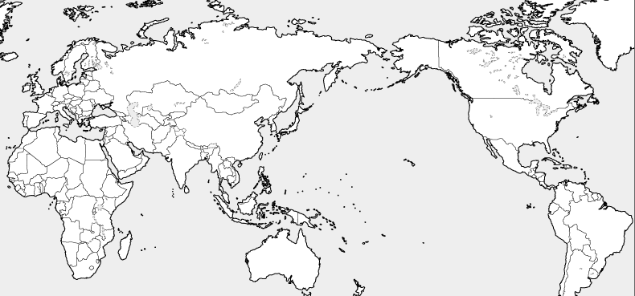
11. The key of the report(4): Examples of tritium emission
[Ref.]Annual Tritium emissions from nuclear facilities around the world
UK・Haysham B NPP
Liquid ：About 390 TBq
(in 2015)
Germany・Gräfen Rheinfeld NPP
Liquid ： About 21 TBq（in 2002, not in operation)
Korea ・Wolseong NPP
Liquid：About 17 TBq
Steam：About 119 TBq
(in 2016)
Canada・Bruce A,B NPP
Liquid ：About 892 TBq
Steam：About 1079 TBq
(in 2015)
Canada・Darlington NPP
Liquid ：About 241 TBq
Steam：About 254 TBq
(in 2015)
UK・Sellafield reprocessing facility
Liquid：About 1540 TBq
Steam ：About 84 TBq
(in 2015)
Germany・Gundremmingen B-C NPP
Liquid ： About 5.9 TBq
Steam ：About 1.2 TBq
(in 2002)
Japan ・Fukushima Daiichi NPP
Liquid：About 2.2 TBq
Steam：About 1.5 TBq
(in 2010)
US・Callaway NPP
Liquid ： About 42 TBq
(in 2002)
Canada・Pickering A,B NPP
Liquid ： About 372 TBq
Steam ：About 535 TBq
(in 2015)
UK・Sizewell B NPP
About 20 TBq (in 2015)
Slovenia・Krsko NPP
Liquid ：About 13 TBq
(in 2002)
US・TMI
Steam ： About 24 TBq
(in 1990-1993)
US・Diablo Canyon1 NPP
Liquid ：About 51 TBq
Steam ：About 11 TBq
(in 2002)
Romania・Cernavoda NPP
Liquid： About 85 TBq
Steam：About 286 TBq
(in 2002)
BWRs in Japan (average)
Liquid：About 0.0316 – 1.9 TBq
Steam: About 0.0770 – 1.9 TBq
(Average:2008～2010)
France ・ La Hague reprocessing plant
Liquid： About 13700 TBq
Steam： About 78 TBq
(in 2015)
PWRs in Japan
Liquid：About 18 – 83 TBq
Steam: 0.44 – 13 TBq
(Average:2008～2010)
US・Brunswick 1 NPP
Liquid： About 0.2 TBq
Steam： About 4.3 TBq
(in 2002)
Spain・Asco NPP
Liquid ： About 95 TBq
(in 2002)
France・Tricastin NPP
Liquid ： About 54 TBq
（in 2015）
US・Grand Gulf NPP
Liquid ： About 2.0 TBq
Steam ： About 2.6 TBq
(in 2002)
Brasil・Angra NPP
Liquid ： About 25 TBq
（in 2002）
Korea・Kori NPP
Liquid ： About 36 TBq
Steam ： About 16 TBq
（in 2016）
Spain・Cofrentes NPP
Liquid ：About 3.1 TBq
Steam ：About 3.9 TBq
( in 2002)
China ・Daya Bay NPP
About 42 TBq
（in 2002）
* Numbers indicate the amount of tritium emissions.
Taiwan ・Maanshan NPP
Liquid ： About 40 TBq
Steam ： About 10 TBq
（in 2002）
Reprocessing facility
BWR or ABWR
PWR
CANDU or HWR
AGR
NPP Accident
Source：UK：Radioactivity in Food and the Environment, 2015
Canada：Canadian National Report for the Convention on Nuclear Safety, Seventh Report
France：Tritium White paper 2016
Korea： FY2016 Survey on environmental radioactivity around the nuclear power plant and evaluation report, KHNP
Other countries ：UNSCEAR｢2008 Annual report｣ Japan : Fukushima Pref. and TEPCO report 2010 (data period from April 1, 2010 to March 11, 2011)
＜Ref.＞1×10¹²Bq≒ about0.019g（Tritiated water）

Slide 20
References
19
Notes:
最後に、昨年11月に実施されたIAEAによる第４回福島第一原発廃炉レビューミッションの概要を説明する。
実施期間は2018年11月5-13日、福島第一原発のサイト内の視察も含むもの。
IAEAのグゼリNEFW課長が団長となり、IAEAから9名、本日お越しいただいている英国、米国、インドネシア、加えてロシアからも専門家が参加した。
スコープには、現在の１Fの状況、前回2015年のビューのフォローアップ、特定のイシューとして、汚染水対策、使用済燃料・燃料デブリの取り出し、廃棄物対策、組織的な問題が含まれる。
As the final part of my presentation, I would like to mention about the fourth IAEA Review mission implemented last November.
The review period was 5th to 11th November, 2018, including on-site visit to Fukushima Daiichi.
The team leader was Director Xerri of NEFW division of IAEA.
The scope of the mission is :
Current situation of Fukushima Daiichi, Follow-up of the previous IAEA review in 2015, and specific issues such as Management of contaminated water, Removal of spent fuel and retrieval of fuel debris, and organizational issues.
レビュー調査団への各国からの参加者
米国：Mr. Leo THOMPSON, Senior Technical Advisor, Savannah River National Laboratory
英国：Ms. Rebecca WESTON, Executive Director, Enterprise, Sellafield Ltd
インドネシア：Mr. Heru UMBARA, Director of Center for Multi Purpose Reactor, National Nuclear Energy Agency (BATAN)

Slide 21
[Ref.7] Decommissioning of TEPCO Fukushima Daiichi NPS (FDNPS)
Fukushima Daiichi Decommissioning is a continuous risk reduction activity to protect the people and the environment from the risks associated with radioactive substances by:
  Removing spent fuel and fuel debris from the Reactor Building
  Reducing the risks associated with contaminated water and radioactive waste
◇ Safe and steady decommissioning is a prerequisite for reconstruction of Fukushima
Spent fuel
(Spent fuel pool)
Fuel that remains after its usage for power generation.
Continuous cooling is needed to suppress the heat
Fuel that has melted and solidified by the accident.
Continuous cooling is needed to suppress the heat
Water
Fuel Debris
Contaminated Water Management
Radioactive Solid Waste Management
Units 1 and 2
Unit 3
Unit 4
Removing fuel from the Spent Fuel Pool
Rubble removal
Installation of fuel removal equipment
Fuel removal
Storage/Transportation
Units 1-3
Fuel debris retrieval
Ascertaining of the situation inside the PCV/ consideration of fuel debris retrieval etc
Fuel debris retrieval
Storage/
Transportation
Current progress
Disassembly of reactor facility, etc
Consideration of scenario and technologies
Design and construction of equipment
Dismantling and other tasks
Extended to 30-40 years

Slide 22
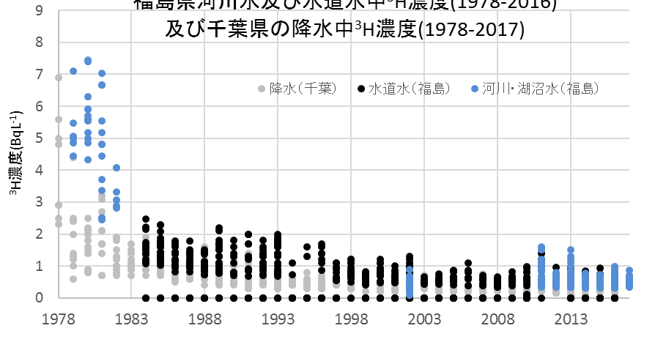
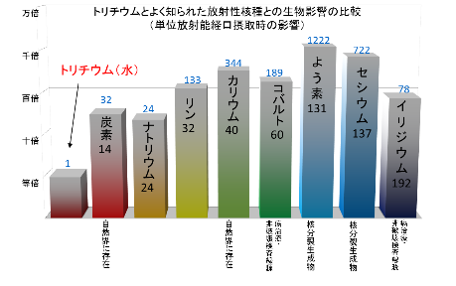
[Ref. 8] What is Tritium?
◇ Tritium is a relative of hydrogen that emits weak radiation.
◇ Tritium exists naturally and is found in water such as water vapor in the atmosphere, rain, sea water, and tap-water, as tritiated water has similar properties as those of water.
It has not been found that tritium concentrates in human beings and particular living organisms
Impact on health is very low, around 1/300 of that of Potassium-40.
(* Potassium-40 is abundant in foods such as vegetables and fruits.)
NPPs in Japan and overseas have been discharging water containing tritium for more than 40 years in compliance with the standard limits based on the laws and regulations.
  Concentration of tritium in sea water near NPPs are significantly lower than that of drinking water standards in the world.
  It has not been found that tritium from NPPs have an impact on health.
  The amount of tritium, which is generated at domestic nuclear power plants (NPPs) and released into the sea annually*, is around 1.7 times as much as that of tritium found in annual precipitation in Japan. (* 5 year average before 2011)
³H concentration in river water and tap water in Fukushima pref.
and ³H concentration in precipitation at Chiba pref.
(1978-2017)
10000 times
1000 times
100 times
10 times
Actual size
Comparison of impact of tritium and well-known radioactive nuclides on living organisms
³H Concentration (BqL⁻¹⁾
Precipitation (Chiba)
Tap water (Fukushima)
River, lake and marsh water
(Fukushima)
Tritium (Water)
Iodine 131
Precipitation (Chiba)
Tap water (Fukushima)
River water, and lake and marsh water (Fukushima)
Cesium 137
Potassium 40
Cobalt 60
Phosphorus 32
Iridium 192
Carbon 14
Sodium 24
Existing in Nature
Existing in Nature
Non-destructive inspection radiation source – Cancer treatment
Fission product
Fission product
Non-destructive inspection radiation source – Cancer treatment
21

Slide 23
[Ref. 9] Impact assessment –UNSCEAR Model* -
UNSCEAR Model*
Made for public exposure assessment in the case of radionuclides discharge, both to the air and into the sea,
on the assumption that there has been constant discharge**.
* Re-assessment was made using national health and nutrition examination survey in Japan.
** assess the public exposure in the 100th year, on the assumption that there will be a continuous and constant discharge for 100 years
[Case 1] Vapor release
Public exposure is calculated as the sum of external dose from the atmosphere and soil, and internal dose from inhaling
the air and ingesting terrestrial life (at 5km points off the leeward side of the FDNPS).
  Rate of the time staying outside: 0.2
  Rate of the local terrestrial food: 0.25
  Amount of Food consumption per person (kg/year): Japan (Ref: Asia+Pacific) (Grains 155 (141.5), Plants/Fruits 188 (240.8), Mild/Dairy products 41.8 (44.5), Meat/Internal organs 35.4(29.5))
[Case 2] Discharge into the sea
Public exposure is calculated as the sum of external dose from beaches and internal dose from ingesting marine life.
For the assessment, sea area is divided into local sea areas (area with 1 billion m³ of sea water) and regional sea area
(with 1000 trillion m³)
  Rate of marine food from local sea area: Fish 0.25, Crustacea 1.0, Mollusk 1.0
  Rate of marine food from regional sea area: Fish 0.75, Crustacea 0, Mollusk 0
  Amount of Food consumption per person (kg/year): Japan (Ref: Asia + Pacific) (Fish 21.7 (6.9), Crustacea 1.42(1.4), Mollusk 1.97 (2.4))
  Other parameters for the assessment
  Assumption of concentration of tritium before dilution : 1 M Bq/L
  (concentration rate will be set to meet the standard before discharge)
  Concentration of radionuclides other than tritium before dilution: Data of the treated water stored in K4 tank area**
  (** Radionuclides that are not detected (ND) is assumed to be 1) their ND value and 2) zero, ¹⁴C = 10Bq/L)
22

Slide 24

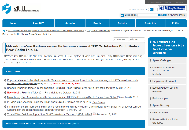
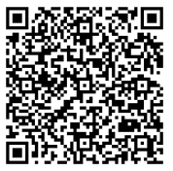
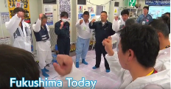

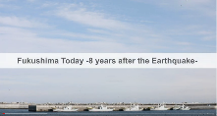
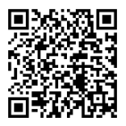

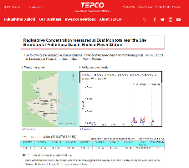
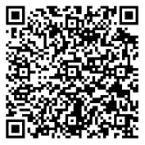

[Ref.10] Information Portal site （１） : Fukushima Daiichi NPS
Decommissioning and Contaminated Water Management
at TEPCO's Fukushima Daiichi NPS
Film, Fukushima Today 2019
- Efforts to Decommission and Reconstruction
    https://www.youtube.com/watch?v=v_PeSp--Wuk
Film, Fukushima Today
- 8 years after the earthquake -
    https://www.youtube.com/watch?v=pKjsSAz5Kws
https://www.meti.go.jp/english/earthquake/nuclear/decommissioning/index.html
Treated Water Portal Site
http://www.tepco.co.jp/en/decommission/progress/watertreatment/index-e.html
Observation Data, Fukushima Daiichi NPS
https://www7.tepco.co.jp/responsibility/decommissioning/1f_newsroom/data/index-e.html
23
Notes:
That’s all for my presentation. Thank you for your attention.

Slide 25


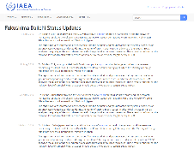
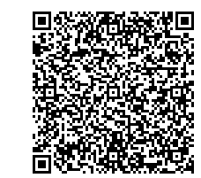
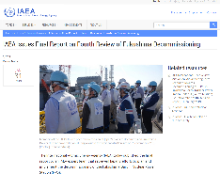


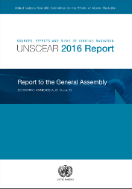
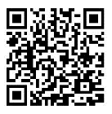
[Ref. 11] Information Portal site （２） : Fukushima Daiichi NPS
Fukushima Daiichi Status Updates
https://www.iaea.org/newscenter/focus/fukushima/status-update
IAEA Review mission reports (Press release )
IAEA Team Completes Fourth Review of Japan’s Plants to Decommission Fukushima Daiichi (November 13, 2018)
https://www.iaea.org/newscenter/pressreleases/iaea-team-completes-fourth-review-of-japans-plans-to-decommission-fukushima-daiichi
IAEA Issues Final Report on Fourth Review of Fukushima Decommissioning (January 31, 2019)
https://www.iaea.org/newscenter/pressreleases/iaea-issues-final-report-on-fourth-review-of-fukushima-decommissioning
UNSCEAR 2016 REPORT
-Sources, effects and risks of ionizing radiation
hhttps://www.unscear.org/unscear/en/publications/2016.html
24
Notes:
That’s all for my presentation. Thank you for your attention.

