Slide 1
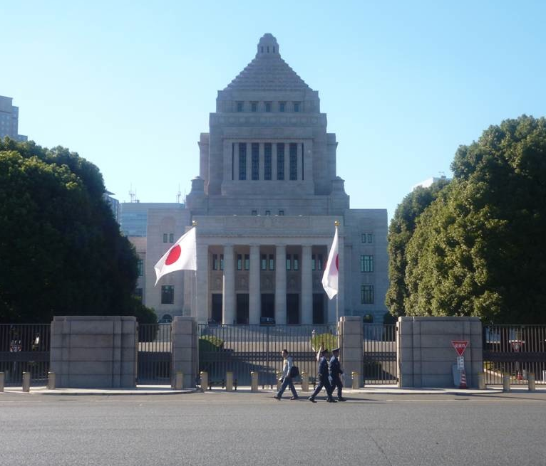
JAPANESE POLITICS Looking Ahead 2019
Foreign Press Center
January 15, 2019
Harukata Takenaka
National Graduate Institute for Policy Studies, Tokyo

Slide 2
Introduction
I. Background: Transformation of the Japanese Political System and the Prime Minister’s Power
II. Prime Minister's Power under the Abe Administration from 2012
III. 2018 Agendas ①:Politics
IV. 2018 Agendas ②:Budget and Tax
V. 2018 Agendas ③:LDP going SDP?
VI. 2018 Agendas ④:Toward an Age of “You Live Until 100 Years Old”
VII. Review of Past Policies ①: Three Arrows
VIII. Review of Past Policies ②: The Third Arrow
IX. Review of Past Policies ③: Legislation of Security Related Bills in Sep. 2015.
X. 2018 Agendas ⑤: Constitutional Amendment
XI. What About Oppositions?

Slide 3
Introduction
1. Lower House

Slide 4
2. Upper House

Slide 5
Agendas for 2019
Jan. Diet Session convenes (Budget and Tax Reform )
Apr. Local elections.
Apr. Emperor abdicates.
May. New Emperor ascends to the throne.
June. G20
July. Upper House election.
Aug. TICAD (Tokyo Intl. Conf. on African Dev.)
Oct. Consumption Tax Hike and ”Free Education” Effective.
Oct. Imerical ascending ceremony

Slide 6
I. Transformation of the Japanese Political System and Prime Minister’s Power
1. Shift from 55 system to a “new” system in 2000s
2. 55 System (1955-1993)
1) Formation of LDP and Social Democratic Party in 1955.
2) Prime Minister with weak political clout.
3) LDP government as a coalition government of between 1955 and 1993.
4) SNTV= One electoral district electing 3 to 5 politicians.
a) Several LDP candidates from the same district.
b) For LDP candidates party label has almost no value.
c) Easy to get elected as an independent candidate.
d) Provides room for factions -> Dominance of factions within the LDP

Slide 7
3. 55 System (1955-1993) as a Consensus Model
 | Consensus Model | 1955 system
Executive power | Coalition cabinet = power sharing | LDP cabinets = coalition cabinets of factions
Executive-legislative relationship | Balance of power | Independent Diet
Party System | Multi-party system | Multi-party system
Electoral System | PR | SNTV
Bicameralism | Strong | Strong

Slide 8
4. Shift toward a Westminster Model
1) Prime Minister with more political clout
2) Closer to a single party cabinet = No more coalition cabinet of LDP factions.
3) Electoral system FPTP + PR → closer to FPTP.
4) Party system conducive to two party system.
 | Westminster Model | Current system
Executive power | Single party cabinet = concentration of power | Single party cabinet= Concentration of power
Executive-legislative relationship | Cabinet dominance | Independent Diet
Party System | Two-party system | Now fluid
Electoral System | FPTP | FPTP+PR (more seats allocated to FPTP)
Bicameralism | Weak | Strong

Slide 9
5. Sources of change
1) Electoral reform of 1994
a) Increased importance of party endorsement (1)More difficult to get elected as independent
(2)One candidate in one constituency
b) Concentration of political funds to parties
2) Administrative reform of 2001
More legal authority to the PM for policy formulation

Slide 10
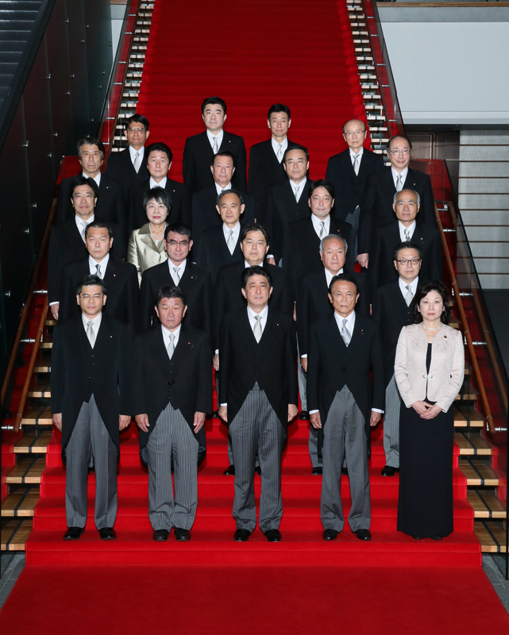
II. Prime Minister's Power under the Second Abe Administration (2012-
1. Further Increase in Prime Ministerial Power
1) PM power in the party
2) PM power in the government

Slide 11
2. PM power increase in the party
1) Norm of “Elected 6 times, then you are a minister” broken!
a) In the past most LDP back benchers who have got elected 6 times could expect to be appointed ministers -> Almost 100%
b) Under the Abe administration this figure has gone down to around 70%.

Slide 13
2) Long Serving Ministers
a) No reshuffling between 2012.12 and 14.9
b) Big Three (2012.12-2017.8)
・Deputy Prime/Finance Minister Aso Taro
・Chief Cabinet Secretary Suga Yoshihide
・Foreign Minister Kishida Fumio
c) Average term of these three ministers from 2000-12.
・Finance (356 days)
・Chief Cabinet Secretary (427 days),
・Foreign (356 days)

Slide 14
3) Any implications for PM power?
Prime minister can now resist pressure from backbenchers for promotion.
4) Where does this power come from? PM's leverage over endorsement

Slide 15
3. PM power increase in the cabinet and enhanced role of the Cabinet Secretariat
1) Cabinet Secretariat
a) Originally set up to deal with routine work
b) Gradually enhanced responsibilities over coordination of policies involving various ministries.
c) 2001 reform increased its authority to support prime minister’s policy formulation
2) Important policies prepared by the cabinet secretariat
a) Key economic policies and intl. economic negotiations
b) Security related bills of 2015 to enhance role of SDF in international military confrontations.

Slide 19
4. Further Institutional Reforms Increasing PM power
1) Introduction of National Security Council (2013. 12) and Security Bureau in the Cabinet Secretariat (2014.1)
-> Enhances prime minister’s power over security policy.
2) Creation of Cabinet Bureau of Personnel Affairs (2014.4)
a) Increased the prime minister's power on appointment of high ranking officials in the ministries.
b) Before the reform the PM had power of veto.
After the reform the PM now can have more substantive power as the ministers have to make pre-appointment consultations with the PM.

Slide 20
III. 2019 Agendas ①:Politics
1. April 2019. Local Elections
2. July 2019. Upper House Election
1) 87 seats: Seats necessary to be obtained by pro constitutional amendment parties.
-> LDP(57), Komei(14), Ishin(6)?? (2016: LDP(58), Komei(14), Ishin (7))
2) 67 seats: Seats necessary to be obtained by the LDP to keep simple majority -> Unlikely.
3) 53 seats: Seats necessary to be obtained by the LDP and Komei to keep majority -> Easy.

Slide 22
IV. 2019 Agendas ②:Budget and Tax
1. FY 2019 Budget
1) 101.4 trillion yen (Deficit 32.7 trillion yen (32.2%))
2) This is expansionary (FY 2018 Budget 97.7 trillion yen)
2. Real FY 2019 Budget
1) FY 2019 Budget + FY 2018 2nd Supplementary Budget
→104.1 trillion yen
2) FY 2018 Budget + FY 2017 Supplementary Budget+ FY 2018 1st Supplementary Budget
→100.3 trillion yen

Slide 23
3. Consumption tax hike in October 2019.
1) 8% to 10% (increase in revenue is 5.2 trillion on annual bases)
2) 3.2 trillion yen will be spent for social security annually.
4. Various measures to cushion consumption tax hike in October 2019 (2 trillion)
1) Points (2% (5% if you go cashless) for small and medium sized shops): 0.27 trillion
2) Special Coupon: 0.17 trillion
3) Public investment:1.3 trillion
4) Other measures:0.2 trillion
5. Expansion of social security expenditure using revenue from consumption tax hike -> 0.71 trillion
-> Total fiscal expansion: 2.7 trillion (Expected national revenue from consumption tax hike for FY 2019 is about 1.5 trillion maximum. ) So, fiscal expansion surpasses revenue.
6. Errors in the collection of statistical data:
1) Mistakes in collecting statistical data on wages by MOHWL since 2004 -> led to underpayment of unemployment allowances.
2) Abe Cabinet has to resubmit the budget.

Slide 24
V. Agendas 2019③: LDP going SDP? Free Education
1. Liberalization of child care (FY 2019 0.38 trillion yen FY2020 0.3 trillion another 0.46 trillion from local government)
1) For all kids who are 3 and 5 years old
2) For 0 and 2 years old children in low income household.
2. More child care facilities (10 billion yen. FY 2020 10 billion yen?)
3. Increase in scholarship for university education for low income household (FY2020 0.72 trillion).

Slide 25
4. PM Abe probably cares about recent findings in social security studies.
1) Total fertility rates correlates with social security spending on working generations.
2) Economic disparity widening in Japan
3) Lower enrollment in university education among children from low income house holds.
5. Political implications
1) LDP becoming very socially democratic.
2) CDP and NDP taken away their policy ideas.

Slide 26
VI. Agendas 2019④: Toward an age of “You Live until 100 years old”
1. To background factors
1) Life expectancy simply getting longer.
a) Male: 81 years b) Female: 87 years
2) Reduction of working age population.
2. Abe Cabinet aims at increasing the number of population among those who are older than 65 years old.
1) First step: Amend Civil Service Law in 2019 to extend retirement age of civil servants from 60 years old to 65 years old.(Only 17% of firms set retirement age at 65 years old)
2) Further step: Encourage companies to hire senior people who are older than 65 years old.

Slide 27
VII. Review of Past Policies①: Three Arrows
1. The First Arrow: Bold Monetary Policy
1) March 2013. Appointment of Governor Kuroda
2) April 2013. Quantitative and Qualitative Monetary Easing
3) October 2014. Additional Easing
4) August 2016. QQME with negative interest rate
5) September 2016, QQME with operations on Long term and Short term interest rate
2. The Second Arrow: Flexible Fiscal Policy
1) Real FY 2013 Budget:¥105.7 trillion (FY2012 Sup Budget (¥13.1 trillion) +FY2013 Budget (¥92.6 trillion))
2) Real FY 2014 Budget:¥100.3 trillion
3) Real FY 2015 Budget:¥99.4 trillion
4) Real FY 2016 Budget:¥100 trillion
5) Real FY 2017 Budget:¥101 trillion
6) Real FY 2018 Budget:¥100.3 trillion
3. The Third Arrow: Structural Reform (Growth Strategy)

Slide 35
VIII. Review of Past Policies②: The Third Arrow
1. TPP11
1) Chronology
a) June 2017 negotiations begin.
b) Nov. 2017 countries agree on “core” part.
c) Jan. 2018 negotiations gets concluded.
d)June. 2018 Japan passes TPP related legislations.
e) Dec. 2018 TPP comes in to effect.
2) Substances
a) Tariff reduction
(1) tariff on beef and other agricultural products reduced.
(2) tariff on auto and auto parts reduced.
b) Speedy custom clearances
c) Expansion of e-commerce (third country server permitted)

Slide 36
2. Japan EU Economic Partnership Agreement
1) Chronology
a) April 2013 negotiations begin.
b) July. 2017 Japan EU reach agreement in principle.
c) Dec. 2017 negotiations get concluded.
d) Aug. 2018 Japan and EU sign the agreement.
e) Dec. 2018 Japan and EU ratify the agreement.
f) Feb. 2019 the EPA will come into effect.
2) Substances: Tariff reduction
a) tariff on all manufactured goods eliminated.
b) tariff on agricultural products reduced (beef, wine)

Slide 37
3. Tax Reforms
1) FY 2014. Reduction of Effective Corporate Tax Rate from 38.01% to 35.6
2) FY 2015. 32.11%
3) FY 2016. 29.77%
4. Electric Service Liberalizations
1) FY 2016. Liberalization of retail market.
2) FY 2020. Complete liberalization -> separation of generating companies and transmission companies

Slide 38
5. Agricultural Reforms to increase competitiveness
1) FY 2014 Introduction of Farmland Management Organization
2) FY 2015 Reduction of Central Union of Agricultural Co-operatives over regional agricultural co-operatives.
3) FY 2016 (LDP proposal) JA (National Association of Agricultural Cooperatives) Reform (the target year of implementation not specified)
a) No more selling of farm machineries and fertilizers to farmers
b) More selling of agricultural products purchased from farmers instead of selling as “agents” of farmers.
3) FY 2018 Repeal of forced reduction of rice production.

Slide 39
6. Corporate Governance Reforms
1) FY 2015 Defacto mandatory introduction of external directors.
2) FY 2014 Introduction of Japanese stewardship code
3) FY 2015 Introduction of Japanese governance code (At least 2 external directors strongly recommended)
4) FY 2016 Guideline on Corporate Governance
a) Disclosure for the status of advisors and councilors
b) Ex CEO’s expected to act as external directors
5) FY 2017 Revised stewardship code
・Institutional investors expected to disclose their voting records on individual agendas

Slide 40
6) FY 2017 TSE Revises requirements for corporate governance report
→ Enlisted companies have disclose status of former presidents who serve as advisors or councilors
7) Abe cabinet will amend corporate law in 2019 to make introduction of external directors mandatory for listed companies.

Slide 41
7. Inviting more foreign visitors
1) FY 2013 10.3 million, FY 14 13.4 million, FY 15 19.7 million, FY16 24.0 million, FY17 28.6million
2) FY 2014 Expansion of Haneda Intl Airport Capacity (0.45 million landing and takeoffs)
3) FY 2014 Expansion of Narita Intl Airport Capacity (0.3 million landing and takeoffs)
4) FY 2016 Daytime Flights from Haneda Airport to the US
5) FY 2020 Further Expansion of Haneda Intl Flight Slots by 40000/year (100/day)
5) FY 2020 (Target) 40.0 million visitors
.

Slide 44
IX. Review of Past Policies③: Legislation of Security Related Bills in Sep. 2015.
1. Dramatic shift from Japanese security policy
1)1980s: Japan concentrates on self defense.
2) Now:
a) Partial exercise of the right of collective self-defense.
b) Combat support for US and other forces
(1) When a situation arises threatening Japanese security.
(2) When there is a UN resolution calling for foreign countries to respond to deal with actions jeoporatizing international peace.
c) More active role in UN PKO.

Slide 45
 | Before | After
Exercise of the right of collective self defense | Impossible | Possible under some conditions: “attack against a foreign country that is in a close relationship with Japan
Combat support for US and other forces 1) | 1) Situations in Areas Surrounding Japan that will have an important effect on Japanese security 2) Combat support very restricted | 1) Situations in Areas Surrounding Japan that will have an important effect on Japanese security 2) Combat support less restricted.
Combat support for US and other forces 2) | 1) New legislation necessary. 2) Combat support very restricted. | 1) Possible with a relevant UN resolution and Diet authorization. 2) Combat support less restricted.
PKO | Impossible to guard other troops or private citizens. | Possible to guard other troops or private citizens.

Slide 46
X. Agenda 2019 ⑤：Constitutional Amendment
1. Development before the current Abe administration.
1) LDP committed to amending constitution since its formation in 1955.
2) LDP had been referring to constitutional amendment since 2000 general elections.
3) April 2012. LDP proposes draft for Constitutional Amendment
2. Abe administration
1) PM Abe has been eager to amend constitution.
2) LDP made a commitment to amend constitution in 14 general election and 16 HOC election
3) May 2017, PM Abe proposes to amend Article 9 and to refer to the SDF in the constitution.

Slide 47
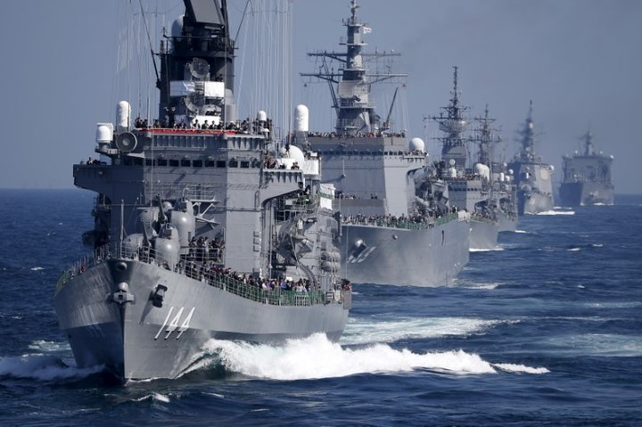
3. In the Oct 2017 election, LDP proposes to amend constitution in the following areas
1) Specific reference to the SDF
2) Free and enrichment of education
3) Responses to emergency situation
4) Elimination of “merged district” in the HOC election.

Slide 48
4. LDP Presidential Election Sep 2018.
1) Before the election PM Abe claims that he will have the LDP submit a formal proposal of amendment to the Diet.
2) After the election, PM Abe says that he will have the LDP explain general ideas about possible amendments.
3) In the extraordinary Diet session in 2018, the LDP did not make any explanations.
5. HOC election 2019
1) If LDP, Komei and Ishin win 87 seats, constitutional amendment will be a political agenda.
(LPD(57), Komei(14), Ishin(6)?? (2016: LDP(58), Komei(14), Ishin (7)))
2) If not, it will fade away.

Slide 49
XI. So, what about Oppositions?

Slide 51
1. CDP leads NDP
2. Eventually opposition parties will merge (NFP, DPJ and then what?)
3. The key is JCP.

