Slide 1
‎‎600 Trillion Yen GDP Target STI Policies for Moving Toward Society 5.0!
Yuko Harayama
Executive Member
Council for Science, Technology and Innovation (CSTI) Cabinet Office
Translation by Foreign Press Center Japan (FPCJ)

Slide 2
Japan’s Growth Strategy
Comprehensive Strategy on Science, Technology and Innovation 2016 (May)
Council for Science, Technology and Innovation
Japan Revitalization Strategy 2016 (June)
Council for Industrial
Competitiveness
“Basic Policy on Economic and Fiscal Management and Reform (June)
Council on Economic and Fiscal Policy
Society 5.0
Fourth Industrial Revolution
600 Trillion Yen GDP

Slide 3
A Brief Overview of the Current Situation in Japan

Slide 4
Labor Productivity Trends
OECD Compendium of Productivity Indicators 2016

Slide 5
Contribution to GDP Growth
Total economy, annual percentage point contribution, 1995-2013
OECD Innovation Imperative (2016)

Slide 6
Trends in Working-Age Population, the Limiting Factor
Working-age population (15-74) in relation to total population 1990-2060
OECD Innovation Imperative (2016)

Slide 7
Share of ICT Investment in GDP
OECD Compendium of Productivity Indicators 2016

Slide 8
Contribution of ICT capital to labour productivity growth
OECD Compendium of Productivity Indicators 2016

Slide 9
Why the Interest in STI?
To reach the target of 600 trillion yen GDP・・・
Investment in STI ➡ Economic growth
Also・・・
Addressing social and global challenges
As a source of industrial competitiveness
Driver of regional development
・・・
Mainstreaming of STI policies (in public policy, particularly economic policy)
OECD, The Innovation Imperative (2015)
➡New challenges:
“Science and technology policies” AND “innovation policies” AND “economic policies”
Participation by diverse stakeholders➡Role of the government?

Slide 10
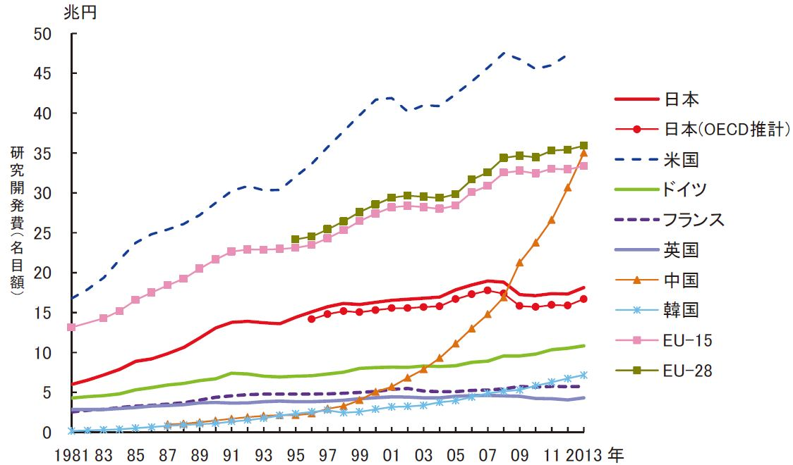
Trends in Upstream R&D Funding
Japanese Science and Technology Indicators 2015
*兆円=trillion yen *Funding is nominal amount.
*日本:Japan, 米国:U.S., ドイツ:Germany, フランス:France, 英国:U.K,
中国：China, 韓国:ROK

Slide 11
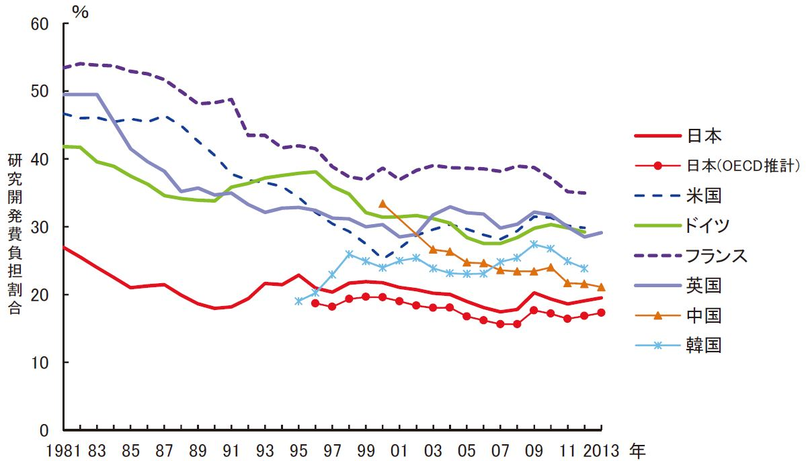
Proportion of Government Funding for R&D
Japanese Science and Technology Indicators 2015
*日本:Japan, 米国:U.S., ドイツ:Germany, フランス:France, 英国:U.K,
中国：China, 韓国:ROK

Slide 12
R&D Funding Used by Field （All sectors including NPOs/Public Agencies, Universities, Businesses)
2nd Science and Tech. Basic Plan
3rd Science and Tech. Basic Plan
4th Science and Tech.Basic Plan
79.1兆円
83.72兆円
17.3兆円
17.5兆円
17.4兆円
リーマンショック
17.5兆円
16.7兆円
16.7兆円
15.6兆円
15.7兆円
15.8兆円
15.8兆円
15.7兆円
16.0兆円
15.9兆円
研究費
15.4兆円
国内総生産（平成13年度を100として指数化）
角括弧[ ]内の数字には資本金1,000万～1億円の企業の使用研究費を含む *兆円＝trillion yen
小括弧( )内の数字は非営利団体、公的機関、大学等、企業、の機関数の合計
使用研究費のうち複数の分野にまたがる研究については、重複して計上されている
出典：内閣府国民経済計算確報及び
総務省統計局科学技術研究調査
より内閣府作成

Slide 13
Japan’s Potential for Growth （１）
Top 10% most cited documents and scientific leading authorship, 2003-12
As a percentage of all documents, whole counts
OECD STI Scoreboard 2015

Slide 14
Japan’s Potential for Growth （２）
Female scientific authors in selected fields, by country, 2011
As a percentage of corresponding authors, estimated shares
OECD STI Scoreboard 2015

Slide 15
Japan’s Potential for Growth （３）
Start-up rates have declined across countries Percentage of start-ups in all businesses
OECD Innovation Imperative (2016)

Slide 16
Fifth Science and Technology Basic Plan and Society 5.0

Slide 17
Where we stand today
Consider the times
Period of Great Change
Connectivity, Openness, Inclusiveness
Beyond existing frameworks ➡ Co-production, Co-creation, Co-…
Data-driven innovation, Social innovation, Platform economy, Shared economy, …
➡ Unpredictable, Unforeseeable, Transformational, Disruptive
Global perspective
Preparedness is the key
Keys for Science, Technology, and Innovation?
Fundamentals
Social experiments＋learning
Creativity
Social acceptance of “difference”
Co-creation beyond existing frameworks

Slide 18
5th Science and Technology Basic Plan （2016-2020）
Three Pillars
Lead this period of great change ➡ Preparing the next: Future industry and society
Proposed and implemented by various stakeholders, in particular young leaders of the next generation
Preemptive action against economic and social issues ➡ Addressing economic and social challenges
Increase potential, which enables efforts to respond to uncertain changes ➡ Development and enhancement of fundamentals
People that act based on deep knowledge, observational skills, and leadership
Continually create diverse, excellent knowledge assets
Initiatives
More open and dynamic innovation systems
More inclusive innovation

Slide 19
Preparing the next: Future industry and society
Exploring game changers
➡Places for debate, discovering ideas
New approaches
System of Systems approach
(Global) Value Chains approach
➡By promoting specific projects
Investing in technologies that provide a common platform
➡Enabling technologies (IoT, AI, Big Data, …)
Society 5.0

Slide 20
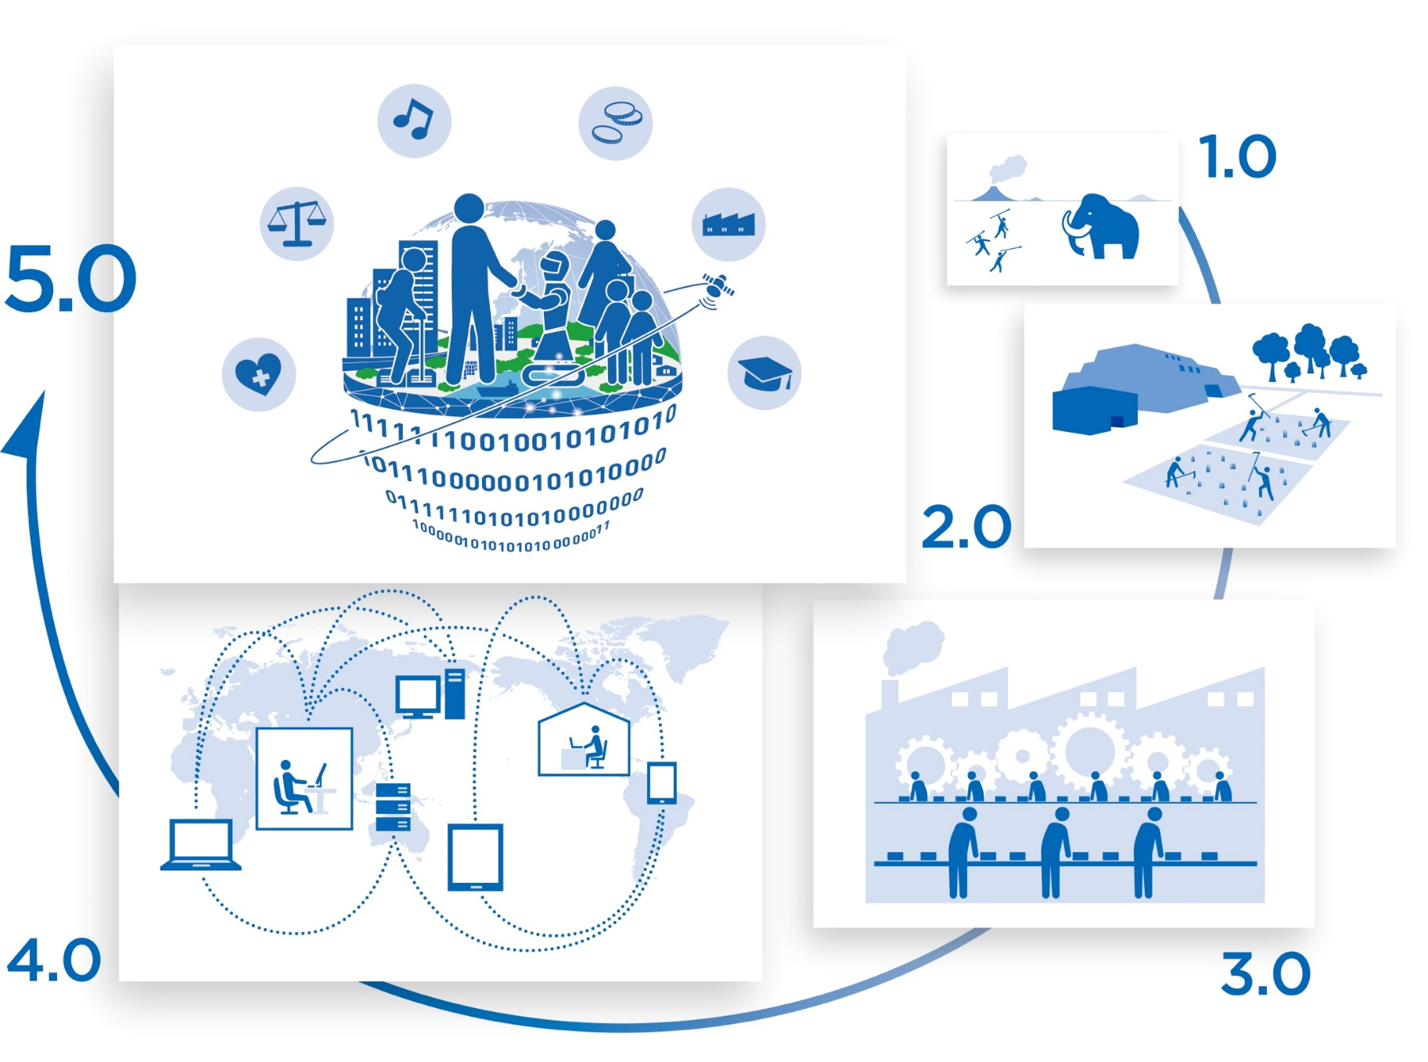
Society 5.0
Hunting & Gathering In symbiosis with Nature
Agriculture
Organization ➡ Nation states
Information Intangible assets + network➡ added value
Industry Mastering of power➡
Mass production

Slide 21
Learn from History
Hunting & Gathering Society
➡ Sustainability
Agricultural Society
➡ Inclusiveness
Industrial Society
➡ Efficiency
Information Society
➡ Power of intellect
Society 5.0
Full use of STI
People as the core
Participation by all
Shared values
Sustainability
Inclusiveness
Efficiency
Power of intellect

Slide 22
In Other Words・・・
Super Smart Society
A society where the necessary goods and services are provided to the people who need them at the right time and in the right amounts, regardless of age, gender, location, language or other limitations, for a fulfilling and comfortable lifestyle where everyone can receive high-quality service
Coexistence of people and robots/AI
Made-to-order services
Elimination of service inequality
Increased opportunities for game changers

Slide 23
Improvement of Fundamental Technologies
Cyberspace
Cybersecurity
Software base
Big data analysis
Artificial intelligence
Devices to process large-scale data at rapid speeds with low power consumption
Networks
Real World
Robotics and actuators
Sensors and optical/quantum technology
Biotechnology (biointerfaces, etc.)
Human interfaces using augmented reality (AR) and haptic engineering
Materials and nanotechnology

Slide 24
Society 5.0 Platform
Integrated
Material R&D
System
New
Services
Smart
Food Chain
System
Hospitality
System
Regional
Inclusive Care
System
Smart Production
System
Disaster
Reduction System
Global
Environment
Data
Platform
Infrastructure
Maintenance
System
Intelligent
Transport
System
Energy
Value
Chain
Monozukuri
System
Base Technologies
AI, Big Data Processing, etc.
Global
Environment
Data
Image
Data
Position
Data
Improved
Data
Exchange
3D Map
Data
Database
○Cybersecurity
○System to Promote Use of Data
○Global IP Standards
○Linked Open Data System ○Unified Data Format
○System/Regulation Reforms ○Training Human Resources
Shared Base Functions

Slide 25
Comprehensive Strategy on STI 2016
Acting to Create New Value for the Development of Future Industry and Social Transformation
Database construction
Promoting valuable uses of data
IP strategy and creation of global standards
System and regulation reforms, and fostering social acceptance
Skill development, training of human resources
Enhancing Fundamentals of STI
Increasing human resource capabilities
Training and opportunities for young researchers, opportunities for women, more flexible movement of human resources
Funding reforms
Reforms for base costs, reforms for public funding, integrated reforms for national universities and research funding
Creation of a Virtuous Cycle for Human Resources, Knowledge, and Funding to Create Innovation
Improvement of systems to promote open innovation
Improve creation of SMEs and start-ups for new business areas
Improve Capabilities for Promotion of STI

Slide 26
What’s next!
The Advisory Panel on Artificial Intelligence and Human Society (May-)
Under Minister of State for Science and Technology Policy
Ethics, law, regulations, economy, social impact➡issues and planned direction
Committee for Promotion of Economic Society and Science, Technology and Innovation (June-)
Under Council on Economic and Fiscal Policy and Council for Science, Technology and Innovation
Fundamental system reforms (systems for training and exchange of human resources, employment conditions, funding distribution, accounting, etc.)
Transparency and evidence for STI policies
STI ➡ Economic stimulus policies and increased annual expenditure efficiency, etc.

